Slide 1
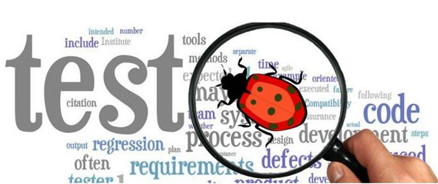
Software Testing Basics

Slide 2
Agenda
Introduction
Why Testing?
Definition
Main Objectives
Misunderstandings about Testing
QC - Quality Control
QA - Quality Assurance
QC vs QA vs Testing
SDLC- Software Development Life Cycle
SDLC Models ( Waterfall Model - V-Model Verification and Validation- Iterative Model- Agile Model)
Defect Concepts and Objectives
Bug, Defect, Incident, Error, Failure, Fault
Bug Tracking System, Priority, Severity
Defect Lifecycle
QA Team Skills and Responsibilities
Testing life cycle
Software Versioning

Slide 3
Agenda (Continued)
Software environments
Alpha Testing and Beta Testing
Static Testing
Informal and Formal Review
Test Design Techniques
Black Box Testing
Risk Based Testing
Test Types
Functional Testing
Non Functional Testing
Test Levels
Independent and Integrated Testing
Automation Testing
Testing Pyramid
Documentation
How to Create Effective Test Case?
Best Practices

Slide 4

Introduction
When you test a program, you want to add some value to it. Adding value through testing means raising the quality or reliability of the program. Raising the reliability of the program means finding and removing errors.
Therefore, don’t test a program to show that it works; rather, you should start with the assumption that the program contains errors (a valid assumption for almost any program) and then test the program to find as many of the errors as possible.
Notes:
LP – quité los dos primeros puntos porque corresponden a la definión de testing (slide 5)
At 1st Stage, Testing is the process of executing a program with the intent of finding errors
At last Stage, Testing is the process of demonstrating that errors are not present (after the completion of all bugs)

Slide 5

Why Testing?
To find and correct defects.
To check whether the Client/User needs are satisfied.
To avoid user detecting problems.
To provide Quality Product.
Quality is the important factor affecting an organization’s long term performance.
Quality improves productivity and competitiveness in any organization.

Slide 6

Definition
Software testing is a process (rather than a single activity) of executing a program or application with the intent of finding the software bugs.
Testing involves operation of a system or application under controlled conditions and evaluating the results
Testing is the process of exercising or evaluating a system or system component by manual or automated means to verify that it satisfies specified requirements.
A set of activities, methods, practices and transformations that people use to develop and maintain software and associated products.
Notes:
Quité lo siguietne:
It can also be stated as the process of validating and verifying that a software program or application or product:
Meets the business and technical requirements that guided it’s design and development
Works as expected
Can be implemented with the same characteristic.
Testing should intentionally attempt to make things go wrong, to determine if things happen when they shouldn't or things don't happen when they should.

Slide 7
Main Objectives
To arrive at a common understanding of the scope of testing activity
To familiarize the audience with the terminology used in the testing work
Understand the required test skills of engineers
Primary: Execute a program with the intent of finding errors to
Determine whether system meets specifications
Determine whether system meets user’s needs
Secondary:
Continuously improve the testing process
Notes:
Cambié el título… Decía Goals and objectives + defincion

Slide 8

Misunderstandings about Testing
Testing is debugging
Testing is not the job of a programmer
If programmers were more careful testing would be unnecessary
Testing never ends
Testing activities start only after the coding is complete
Testing is not a creative task

Slide 9
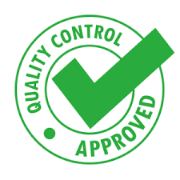
QC - Quality Control
Quality Control is the process by which product quality is compared with the applicable standards and the action taken when non conformance is detected.
It is product oriented
Defect detection based
QC is the set of procedures used by organizations to ensure that a software product will meet its quality goals at the best value to the customer, and to continually improve the organization’s ability to produce software products in the future.
Quality control is any end-of-cycle activity that aims at evaluating the product to detect bad characteristics.
Software quality control refers to specified functional requirements as well as non-functional requirements.
These specified procedures and outlined requirements leads to the idea of Verification and Validation and software testing.

Slide 10

QA - Quality Assurance
Quality assurance involves all activities that aim at evaluating and improving processes to build good quality into the product and to prevent bad characteristics from getting into the product.
Quality Assurance is a planned and systematic set of activities necessary to provide adequate confidence that products and services will conform to specified requirements and meets user needs.
It is process oriented.
Defect prevention based.
Throughout the Life Cycle.
It’s a management process.

Slide 11
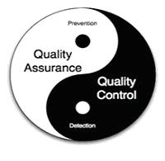
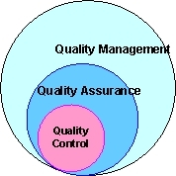
QC vs QA vs Testing
Quality Assurance makes sure that we are doing the right things, the right Way.
QA is preventive and proactive process.
QA deals with process.
QA focuses on building in quality and hence preventing defects.
QA is for entire life cycle.
Quality Control makes sure the results of what we’ve done are what we expected.
QC is corrective process.
QC deals with product.
QC focuses on testing for quality and hence detecting defects.
QC is for testing part in SDLC (Systems Development Life Cycle).
Is testing a quality assurance activity or a quality control activity?
Software Testing is a quality control activity aimed at evaluating a software item against the given system requirements.
Notes:
Eliminaría las slides de QA y QC y dejaría solo la comparative

Slide 12
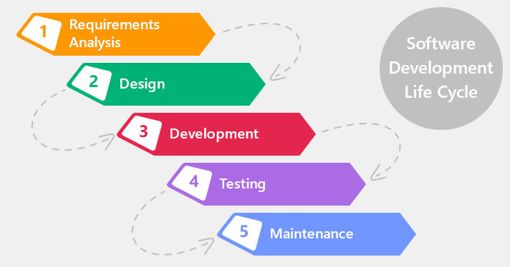
SDLC- Software Development Life Cycle
What is the SDLC Model?
“Software development life cycle” model describe phases of the software cycle and the order in which those phases are executed.
There are many models, and many companies adopt their own, but all have similar patterns or references.
The life cycle begins when an application is first conceived and ends when it is no longer in use
Initial Concept
Requirements Analysis
Functional Design
Internal Design
Documentation Planning
Test Planning
Coding
Document Preparation
Integration Testing
Testing
Maintenance
Updates
Retesting
Reports
Phase-Out

Slide 13
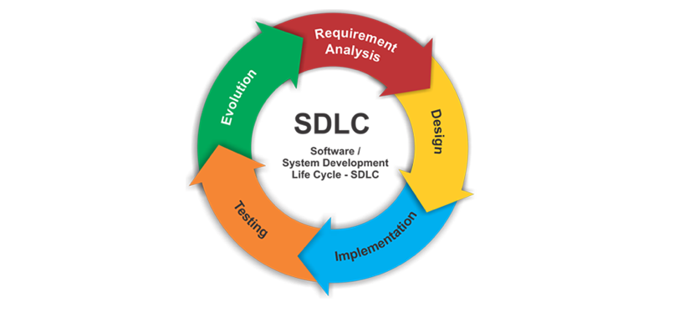
SDLC Models
V-Model
Waterfall Model
Iterative Model
Agile Model
…

Slide 14
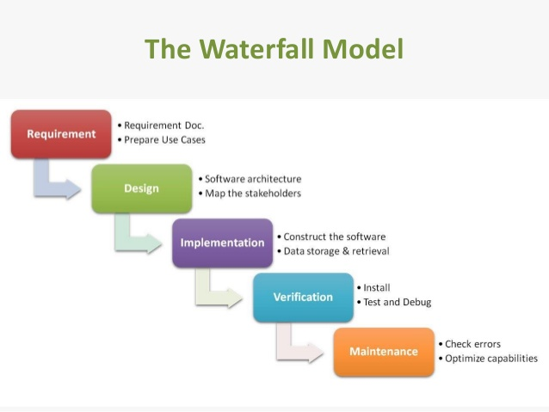
Waterfall Model
Approach: Discrete phases, a review after each phase will decide to move next or stay at this phase till it’s ready.
Advantages: Easy to test (clear requirements), easy to manage and monitor.
Disadvantages: High bugs fixing and changes cost, the customer has minimal involvement during the project.

Slide 15
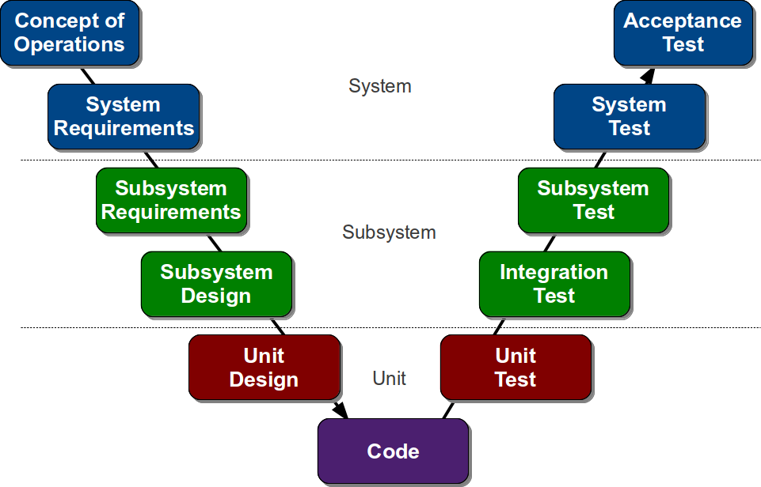
V-Model
Approach: For every single phase in the development cycle there is a directly associated testing phase. It is an extension of the waterfall
Advantages: Testing exists in every phase. Defects are detected early.
Disadvantages: Time consuming.

Slide 16
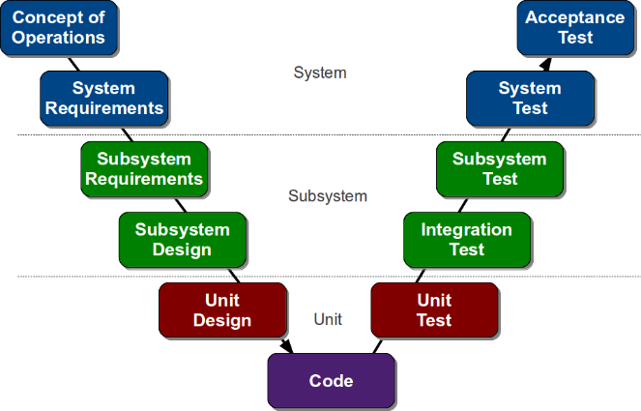
Verification and Validation
Verification:
Are we building the product right?
Confirming that something (software) meets its specification done through inspections and walkthroughs
Use: To identify defects in the product early in the life cycle
Validation:
Are we building the right product?
Confirming that it meets the user’s requirements.
Use: It is the actual testing.
The two major V&V activities are reviews and testing.
Testing is part of the V&V activities.
Validation
Verification

Slide 17
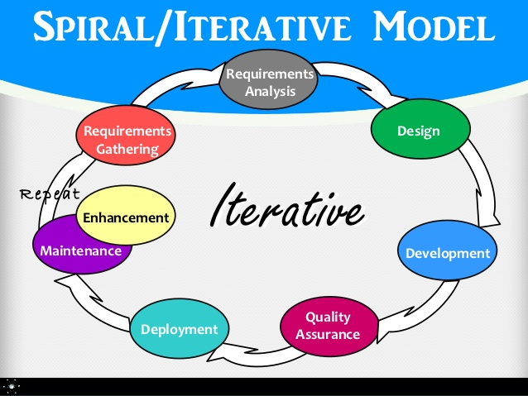
Iterative Model
The Approach: Dividing the project into builds, each build can be executed by waterfall model.
Advantages: Easy to test, customer is tightly Involved, change cost is low.
Disadvantages: Time consuming.

Slide 18
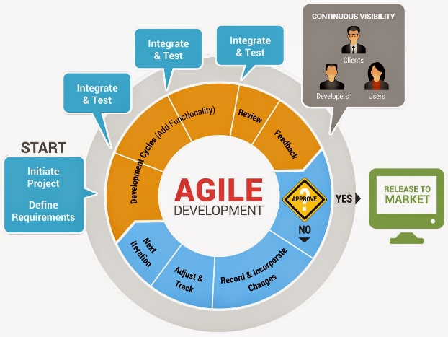
Agile Model
Approach: Set of values and principles for software development under which requirements and solutions evolve through the collaborative effort of self-organizing cross-functional teams. Software is developed in incremental, rapid cycles. This results in small incremental releases with each release building on previous functionality. Each release is thoroughly tested to ensure software quality is maintained. It is used for time critical applications.
Advantages:
Customer satisfaction by rapid, continuous delivery of useful software.
People and interactions are emphasized rather than process and tools. Customers, developers and testers constantly interact with each other.
Working software is delivered frequently (weeks rather than months).
Face-to-face conversation is the best form of communication.
Close, daily cooperation between business people and developers.
Continuous attention to technical excellence and good design.
Regular adaptation to changing circumstances.
Even late changes in requirements are welcomed
Disadvantages:
In case of some software deliverables, especially the large ones, it is difficult to assess the effort required at the beginning of the software development life cycle.
There is lack of emphasis on necessary designing and documentation.
The project can easily get taken off track if the customer representative is not clear what final outcome that they want.
Only senior programmers are capable of taking the kind of decisions required during the development process. Hence it has no place for newbie programmers, unless combined with experienced resources.

Slide 19
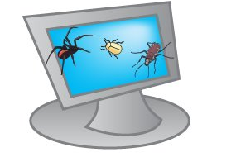
Defect Concepts and Objectives
Understand the definition of defect
Understand the cost of a bug to software development
As we go deeply into the SDLC process, bugs are more expensive
Understand the common types of defects and their perceived severity

Slide 20
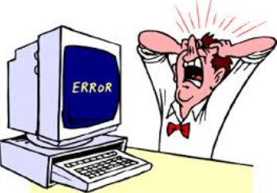
Bug, Defect, Incident, Error, Failure, Fault
Error: Human action that produces the incorrect result that results in a fault.
Fault : State of software caused by an error.
Bug : The presence of error at the time of execution of the software. Things the software does that while it is not supposed to do, or something the software doesn't while it is supposed to.
Failure : Deviation of the software from its expected result. It is an event.
A person makes an Error, That creates a Fault in software, That can cause a Failure in operation
Defect: Any error found by testing and reviewing activities (All errors found by internal reviewer, external reviewer and customer).
Incident: It can be Bug, Defect, etc. depends on the root cause
Where defects come from?
Miscommunication or no communication.
Programming errors.
Changing requirements.
Time pressures.
Ego.
Poorly documented code.
Software development tools.
…

Slide 21
Bug Tracking System, Priority, Severity
Severity: How bad the problem is, impact on the system (sometimes disagreement between Dev & Tester)
Fatal: the system is broken
Critical: can not work around
Major: high impact the function
Medium: impact the function
Minor: minimal impact the function
Cosmetic: not impact the function
Priority: How urgent the defects need to be resolved
Critical: need to be resolved immediatelly
High: need to be resolved within 2 hours
Medium: need to be resolved within 4 hours
Normal: need to be resolved within 1-2 days
Low: need to be resolved within 1 week

Slide 22

Defect Lifecycle

Slide 23

QA Team Skills and Responsibilities
Main Qualifications for a Good Software Tester:
Be familiar with the SDLC being used.
Have excellent attention to details.
Have excellent communication skills (oral and written).
Have strong personality and the ability to resist pressures and say 'no' to other managers when quality is insufficient.
Be able to run meetings and keep them focused.
Patient, Mature and diplomatic.
Able to prioritize things and take critical decisions.
What testers should not do?
Fix the bugs!
Test with good faith!
Test with no requirements!
Not to report the obvious bugs!
Mock at others because of their bugs!

Slide 24
Testing lifecycle
Testing Lifecycle main activities:
Requirement Review
Test Planning
Test Analysis and Design
Test Cases Preparation
Test Environment Setup
Test Execution
Test Reporting and Monitoring
Bugs Reporting and Regression Testing
Releasing Reporting
User Acceptance

Slide 25
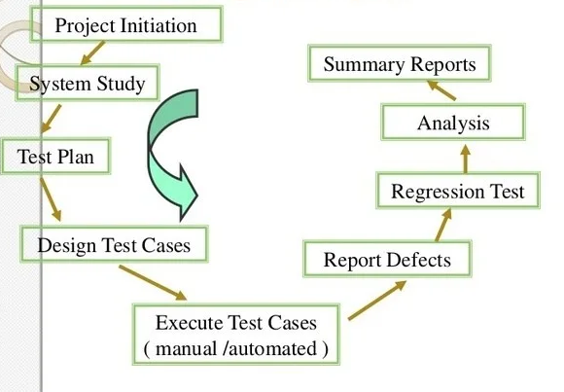
Testing lifecycle

Slide 26
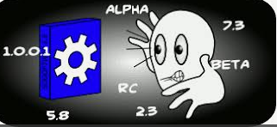
Software versioning
Software versioning is the process to assign a name or unique number to a software to indicate the developer level
Usually two number are assigned, and they are increasing meantime the software develop is growing .
Each number is increasing according to the changes that the software is producing :
- Major : Suffers bigger changes (X.0)
- Minor : Suffer smaller changes or bugs ( 1.X)
- Micro: a correction is applied (1.1.X)

Slide 27
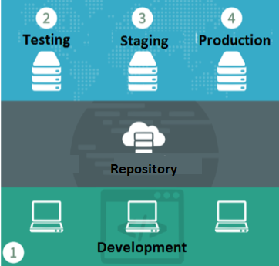
Software environments
Software environment is the term commonly used to refer to support an application.

Slide 28
Alpha Testing and Beta Testing
Alpha Testing
The application is tested by the users who doesn’t know about the application.
Done at developer’s site under controlled conditions.
Under the supervision of the developers.
Beta Testing
This Testing is done before the final release of the software to end-users.
Before the final release of the software is released to users for testing where there will be no controlled conditions and the user here is free enough to do whatever he wants to do on the system to find errors.
Done at client’s site

Slide 29
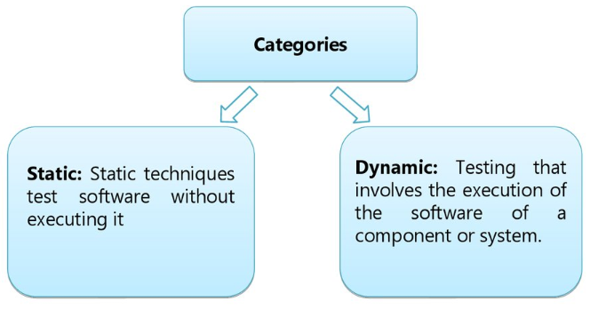
Test Design Techniques
Help to select good set of tests from all possible tests of a given system

Slide 30
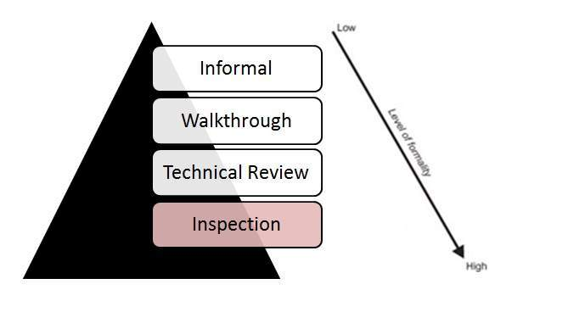
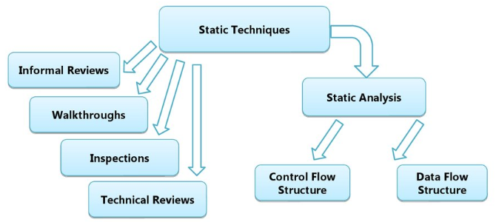
Test Design Techniques
Help to select good set of tests from all possible tests of a given system
Static:
Rely on the manual examination and automated analysis of the code or other project documentation without the execution of the code.
Performed during verification.
Types of reviewers
Informal Review
Walkthrough
Technical Review
Inspection

Slide 31
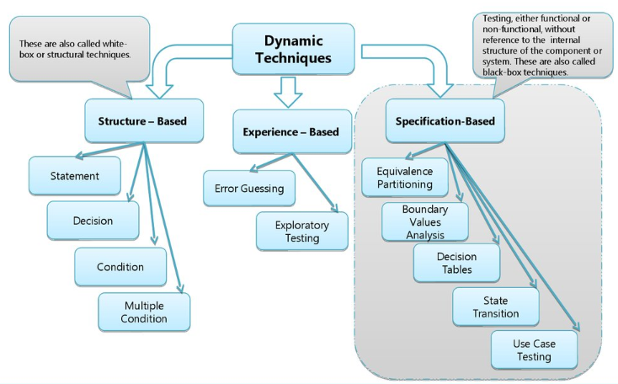
Test Design Techniques
Dynamic: Execute the software code.
Specification Based - Black Box (behavioral)
Focuses on functional requirement of the software
Derive sets of input conditions that will fully exercise all functional requirements for a program
Not an alternative to white box
Structure Based - White Box (at all levels)
It guarantees that all independent paths within a module have been exercised at least once
Exercise all logical decisions on their true an false sides
Execute all loops their boundaries and within their operational bounds
Exercise internal data structures to assure their validity
Experience Based - Black Box
Experience from previous projects, skill set useful under extreme time pressure in small projects
Error Guessing Testing
Exploratory Testing

Slide 32
Informal and Formal Review
Informal Review
Performed in early stages of the lifecycle of the document
Team of 2 people
Improve the quality of the document
Not documented
Formal Review
Follow formal process, well structured & regulated
Contain 6 main steps:
Planning (Lead by Moderator, entry, exit criteria)
Kick-Off (optional, introduction)
Preparation (Reviewers perform the review individually, 5-10 pages per hour)
Review meeting (logging phase (defects), discussion phase, decision phase)
Rework (document to be reworked, defects to be resolved)
Follow-Up (moderator check to make sure that the author has taken actions on all known defects or to the one that has been decided)

Slide 33
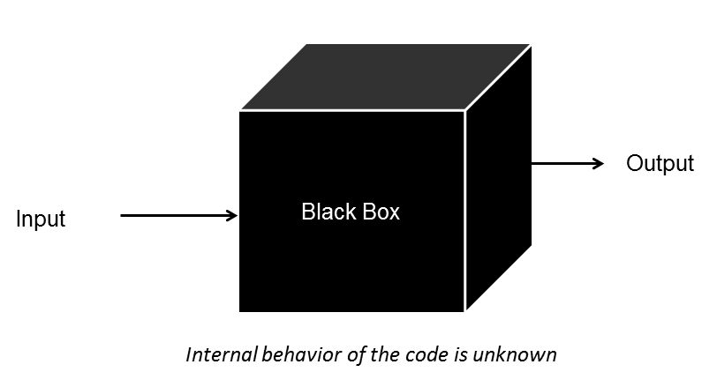
Test Design Techniques Black Box Testing
Includes Functional (what system does) and Non functional (how the system does, how well)
Appropriate on all levels of testing from Component to UAT
Equivalence Partitioning/Classes-EP/EC (at all levels, divide set conditions and pick up one value from each partition)
Boundary Value Analysis-BVA (testing boundary values)
Decision Tables (in case of more inputs, more rules for one scenario)
State Transition Testing (state diagram, IF-THEN-ELSE)

Slide 34
Black Box Testing - Equivalence Partitioning
The test cases are designed to execute representatives from equivalence partitions.
Idea: Inputs to the software are divided into groups that are expected to exhibit similar behavior, so they are processing in the same way. In principle test cases are designed to cover each partition at least once.
Example: We have to test a field which accepts Age 18 – 56
Equivalence Partitioning
Invalid | Valid | Invalid
<=17 | 18-56 | >=57

Slide 35
Black Box Testing - Boundary Value Analysis-BVA
It is an input value or output value which is on the edge of an equivalence partition or at the smaller incremental distance on either side of an edge, for example the minimum or maximum value of a range.
Idea: Divide test conditions into sets and test the boundaries between these sets. Tests should be written to cover each boundary value.
Example:
If we want to test a field which should accept only amount more than 10 and less than 20.
Then we take the boundaries as: 9, 10, 11,19, 20, 21.

Slide 36
Black Box Testing – Decision Tables
A table showing combinations of inputs and/or stimuli (causes) with their associated outputs and/or actions (effects), which can be used to design test cases.
Idea: Divide test conditions into constraints, which could get positive or negative meanings, and rules which identify output based on values of conditions. While analyzing each possible variant of positive and negative meanings identify output or set of outputs for each variant based on the rules. Only combinations of these positive and negative meanings, which uniquely identify decisions that are made, should be covered by tests.
Example: If you hold an "over 60s" rail card, you get a 34% discount on whatever ticket you buy. If you hold family rail card and you are traveling with a child (under 16), you can get a 50% discount on any ticket. If you are traveling with a child (under 16), but do not have family rail card, you can get a 10% discount. You can use only one type of rail card.

Slide 37
Black Box Testing – Decision Tables
Example:
If you hold an "over 60s" rail card, you get a 34% discount on whatever ticket you buy.
If you hold family rail card and you are traveling with a child (under 16), you can get a 50% discount on any ticket.
If you are traveling with a child (under 16), but do not have family rail card, you can get a 10% discount.
You can use only one type of rail card.
Solution: There are 3 conditions, so there can be 8 combination of rules.
Causes (Inputs) | R1 | R2 | R3 | R4 | R5 | R6 | R7 | R8
Over 60s rail card? | Y | Y | Y | Y | N | N | N | N
Family rail card? | Y | Y | N | N | Y | Y | N | N
Child also traveling? | Y | N | Y | N | Y | N | Y | N
Effects (Outputs)
Discount(%) | X/?/50% | Y/?/34% | 34% | 34% | 50% | 0% | 10% | 0%
Question mark is added because specification does not say what happen if somebody holds more than 2 cards. Check Rules 3 and 4, both output 34%, so 3rd cause does not matter.

Slide 38
Black Box Testing – Decision Tables
Causes (Inputs) | R1 | R2 | R3 | R5 | R6 | R7
Over 60s rail card? | Y | Y | Y | N | N | N
Family rail card? | Y | Y | N | Y | Y | N
Child also traveling? | Y | N | - | Y | N | Y
Effects (Outputs)
Discount(%) | 50% | 34% | 34% | 50% | 0% | 10%
Here table can be rationalized like this to reduce test cases. R6 and R8 also combined because having a family rail card has no effect if you are not traveling with a child.
Here are the test cases.

Slide 39
Black Box Testing – State Transition
Test cases are designed to execute valid and invalid state transitions. A transition between two states of a component or system.
Idea: Design diagram that shows the events that cause a change from one state to another. Tests should cover each path starting from the longest state combination.
Example: Client of the bank would like to take money from bank account using cash machine. To get money he should enter valid Personal Identity Number (PIN). In case of 3 invalid tries, cash machine eats the card.
#
Pin not OK
Card Inserted
Eat Card
#
#
#
#
#
Wait for PIN
Enter
Pin not OK
1rd try
2rd try
Pin not OK
3rd try
Pin OK
Pin OK
Pin OK
#
Access to Account

Slide 40
Black Box Testing – Use Case Testing
It is a technique that helps us identify test cases that exercise the whole system on a transaction by transaction basis from start to finish.
Use cases describe the process flows through a system based on its most likely use
This makes the test cases derived from use cases particularly good for finding defects in the real-world use of the system.
Each use case usually has a mainstream (or most likely) scenario and sometimes additional alternative branches (covering, for example, special cases or exceptional conditions).
Each use case must specify any preconditions that need to be met for the use case to work.
Use cases must also specify post conditions that are observable results and a description of the final state of the system after the use case has been executed successfully.

Slide 41
Black Box Testing Choosing a Test Design Technique
Which technique is best? This is the wrong question!
Each technique is good for certain things, and not as good for other things, some techniques are more applicable to certain situations and test levels, others are applicable to all test levels.
The internal factors that influence the decision about which technique to use are:
Tester knowledge and experience
Expected defects
Test objectives
Documentation
Life cycle model
The external factors that influence the decision about which technique to use are:
Risks
Customer and contractual requirements
System type
Regulatory requirements
Time and budget

Slide 42
Risk Based Testing
Uses Risks in order to prioritize the tests
Risk is probability of occurrence of an undesirable outcome
Starts early in the SDLC
Identify the risk of system quality
Involves mitigation
Measuring how well we doing on finding & resolving defects
Make a list of risks
Test all the risks
Adjust the list if some risk is gone and new comes
Risk Analysis
Reading the Requirement specification, design, user documentation, etc.
Brainstorming with the team & stakeholders
Small group sessions with the business or technology experts
Configuration Management
Change of the products so often
Organizational issues (training, stuffing, communication, etc.)

Slide 43
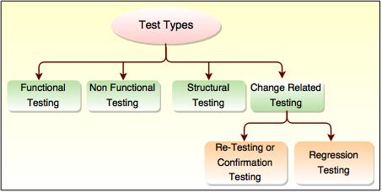
Test Types
Functional (What to do?)
Non Functional (How to do?)
Structural (White box)
Change Related Testing

Slide 44

Functional Testing
System Testing - requirement based
Business process-based Testing (day to day business use)
Smoke Testing: Non-exhaustive software testing, ascertaining that the most crucial functions of a program work, but not bothering with finer details
Sanity Testing (whether to proceed or not?)
Regression Testing: Testing with the intent of determining if bug fixes have been successful and have not created any new problems. Also, this type of testing is done to ensure that no degradation of baseline functionality has occurred.
UAT Testing

Slide 45
Non Functional Testing
Performance: the response time, utilization, and throughput behavior of the system.
Volume : Testing a software application for a certain data volume. Find the maximum limit od data volume
Load : Creating demand on a system or device and measuring its response.
Stress: Determine the stability of a given system or entity. Estimate the peak load (maximum number of users)
Compatibility : Measures how well the system operates on different operating environments.
Recovery : Testing a system's ability to recover from a hardware or software failure.
Availability: Is it available when and where I need to use it?
Efficiency: The amount of code and testing resources required by a program to perform a particular function?
Flexibility: How easy is it to add new features?
Maintainability: How easy it is to correct defects or make changes?
Portability: Can it be made to work on other platforms?
Security: The system’s ability to resist unauthorized attempts at usage or behavior modification, while still providing service to authorized users.
Accessibility testing: measure how well the system interface serve users with disabilities.
Reliability: How long does it run before causing a failure?
Reusability: How easily can we use components in other systems?
Usability: How easy is it for people to learn or to use?
Installability: How easy is it to correctly install the product.
Baseline: Requirement specification validation, validation of documents
Compliance: Compliance with IT Standards of the company
Documentation: Creation of the documents
Endurance: Significant load over significant period of time
Scalability: Application is capable to scale with different conditions, loads, data volume, users, etc.
Spike: Sudden large spikes in the load

Slide 46
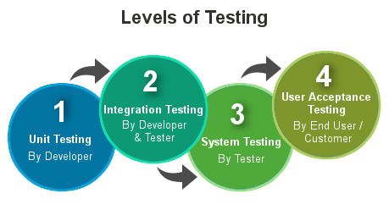
Test Levels
Unit Testing (Done by Developers)
Test each module individually
Follows the white box testing (Login of the program)
Code meets the requirements, classes, functions, interfaces, procedures
Component Testing (Module Testing)
Integration Testing (Combining two or more modules)
After completing the unit testing and dependent modules development, programmers connect the modules with respect to HLD for Integration Testing through below approaches.
System Integration Testing (Testing whether multiple systems are integrated and work correctly)
System Testing (Testing full application based on the requirements)
User Acceptance Testing (Based on the user needs and testing will be done in client place)
A formal test conducted to determine whether or not a system satisfies its acceptance criteria and to enable the customer to determine whether or not to accept the system. It is the final test action before deploying the software.
The goal of acceptance testing is to verify that the software is ready and can be used by the end user to perform the functions for which the software was built.
Alpha Testing
Beta Testing

Slide 47

Independent and Integrated Testing
Independent Tester/Team
Can see more, other, and different defects than a tester working within a programming team.
Brings a different set of assumptions to testing and to reviews, which helps expose hidden defects and problems.
Reports the issues honestly to the senior management.
Things to be considered for an independent test team:
Project size, the application domain, and the levels of risk, among other factors.
As the size, complexity, and criticality of the project increases, it is good to have independence in later levels of testing (like integration test, system test and acceptance test)
Some testing is often best done by other people such as project managers, quality managers, developers, business and domain experts or infrastructure or IT operations experts.
Issues in Independent Test Team
Other project stake-holders might see the independent test team - rightly or wrongly - as a bottleneck and a source of delay.
Some programmers abdicate their responsibility for quality, saying, 'Well, we have this test team now, so why do I need to unit test my code?'
It's especially important for testers and test managers to understand the mission they serve and the reasons why the organization wants an independent test team.
The entire test team must realize that, whether they are part of the project team or independent, they exist to provide a service to the project team.
There is no one right approach to organize testing

Slide 48
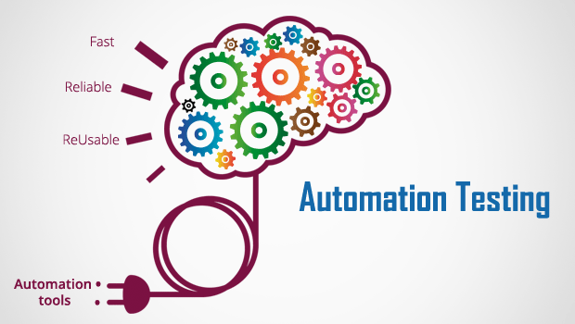
Automation Testing
Manual Testing is performed by a human sitting in front of a computer carefully executing the test steps. Automation Testing means using an automation tool to execute your test case suite. The automation software can also enter test data into the System Under Test, compare expected and actual results and generate detailed test reports.
When to automate an application:
Requirements do not change frequently
Access the application for load and performance with many virtual users
Steady Software with respect to manual testing
Obtainability of time
Huge and serious projects
Projects that need to test the same areas often
Simple Steps to follow in Automation testing:
Identify areas within software to automate
Choose the appropriate tool for test automation
Write test scripts
Develop test suits
Execute test scripts
Build result reports
Find possible bugs or performance issue

Slide 49

Automation Testing
Benefits of Automation Testing
Increase productivity
Saves money
Increases software quality
Reduces testing time
Support various applications
Increase testing coverage
Reduction of repetitive work
Greater consistency
Risks involved in Automation testing:
Starting cost for Automation is very high
Automation is not 100%
Do not automate unfixed UI
Is your application is constant sufficient to automate additional testing work
Tester should have good programming knowledge

Slide 50
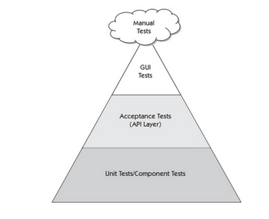
Testing Pyramid
The agile test automation pyramid shows three different layers of automated tests. The lowest tier is the foundation that supports all of the rest. It’s mainly made up of robust unit tests and component tests, the technology-facing tests that support the team. This layer represents the bulk of the automated tests. They’re generally written in the same language as the system under test, using the xUnit family of tools

Slide 51

Documentation
Test Strategy
Test Plan
Test Case
Test Report
…

Slide 52
How to Create Effective Test Case?
What are the characteristics of a good and effective Test Case?
Testability, easy to be executed
Use active case, do this, do that, system displays this, does that
Simple, conversational language
Exact, consistent names of fields, not generic
Don’t explain Windows basics
10-15 steps or less. In the case of integration test case’s try to provide references instead of explaining the functionality again and again
Always update your test cases along with new build

Slide 53

Best Practices
Analytical Risk Based Strategies comes with a lot of benefits
The Test Objectives and Goals should be clear
Improvement in the test process continually
Testing teams should be trained and certified
Quality on the first place
Keep an Eye on the Bigger Picture
Ask Questions
Practice Good Test Management and Reporting
Adopt a Technical Mindset
Build Credibility with Business Stakeholders
Always Keep Learning

Slide 54


